Slide 1

Artificial intelligence
Connected to AutoEcoCharge

Slide 2
What would this artificial intelligence be?
Developing an artificial intelligence (AI) to count the amount of electrical energy generated by the AutoEcoCharge panel and identify damage to the piezoelectric pads can be divided into three main steps: data collection, information processing and communication of results .

Slide 3

General System Architecture
Sensors and Hardware
Module Piezoelectric : Each tablet piezoelectric must be equipped with sensors to measure :
Voltage generated .
Electric current .
Temperature (to detect overheating) .
Controller : A microcontroller (e.g. Arduino, Raspberry Pi) will be used to collect the data in real time and send it to the AI.

Slide 4
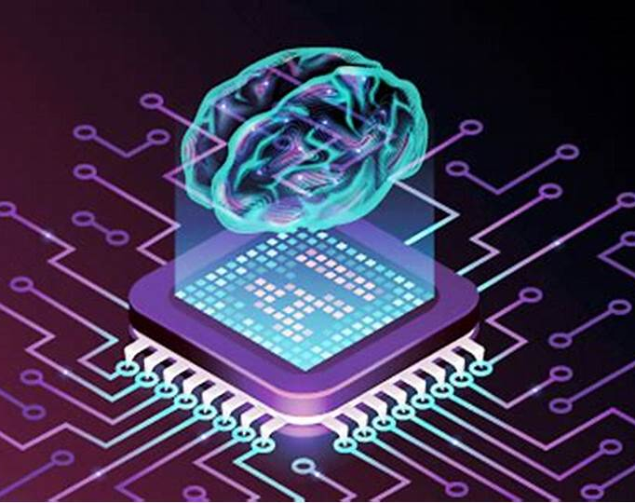
Artificial intelligence
Training and Algorithms
Power Generation Forecasting Model​​
Utilize historical energy data​ generated in different conditions ( pressure , temperature , and traffic ) to train a Machine Learning model ( e.g., linear regression , simple neural networks ).
The model predicts the energy expected based on the parameters current collected .
Anomaly Detection​
Implement an anomaly analysis system to identify​​ discrepancies in the data. For example :
Variations abrupt in the power generation​ they can indicate failures or pad wear .​
Lack of power generation​ in one unit specific suggests damage .
Problem Classification​
Use neural networks or decision trees for categorizing​ problems such as " wear and tear ", " damage physical " or " failure electrical ".

Slide 5
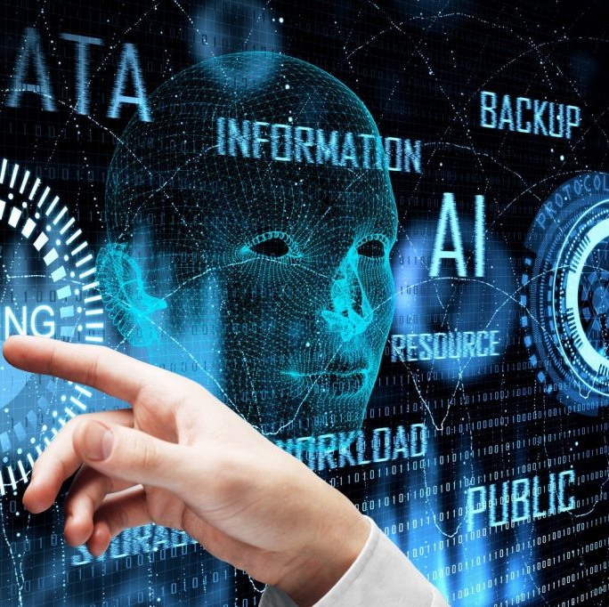
Communication of Results
Visualization and Alert
Real-Time Control Panel
Develop a dashboard accessible via web or app to visualize:
Energy generated by each panel.
Performance graphs.
Anomaly alerts.
Automatic Notifications
Set up an alert system via email, SMS or in-app notification to communicate detected faults.
Report the type of problem identified and suggest actions (e.g.: "Tablet X requires physical inspection").

Slide 6

Recommended Technologies
Hardware
Microcontrollers : Arduino or Raspberry Pi.
Voltage and current measurement sensors .​
Software and AI
Python : For data processing and AI ( libraries) such as TensorFlow, Scikit-learn, Pandas).
Database : MySQL or Firebase to store data.
Web/App Frameworks : Flask or Django for the dashboard.
Data Communication
Use protocols as MQTT or HTTP to send the data from the microcontroller to a server .

Slide 7
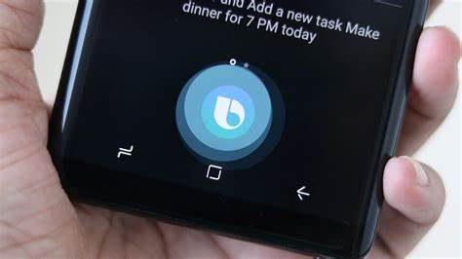
Operational Flow​
Data Collection : The sensors measure voltage and current generated by the pads.
Local Processing : The Microcontroller processes basic data and sends to the server .
Analysis by AI : AI compares the data received with patterns normal and detects anomalies .
Communication of Results : The data analyzed they are presented in real time on the dashboard and alerts they are sent in case of failures .

Slide 8
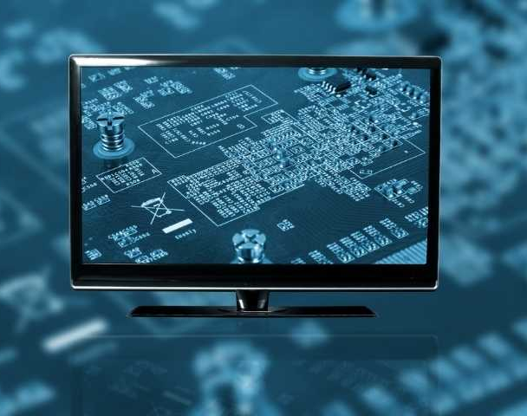
Final considerations
This solution ensures constant monitoring , predictive maintenance and optimization of the AutoEcoCharge system performance.

